Slide 1
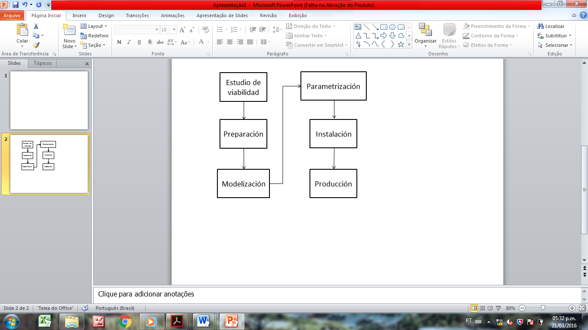
Fig.1

Slide 2
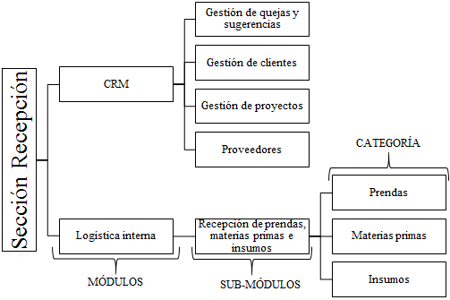
Fig.2

Slide 3
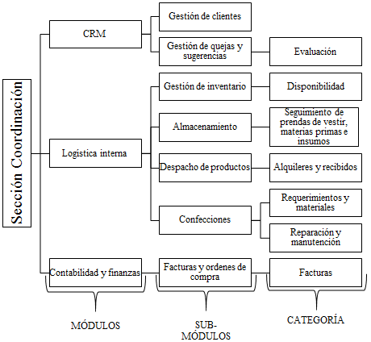
Fig.3

Slide 4
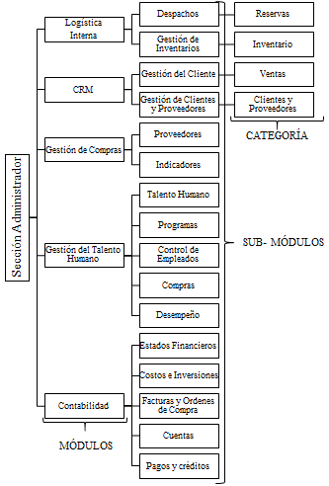
Fig.4

Slide 5
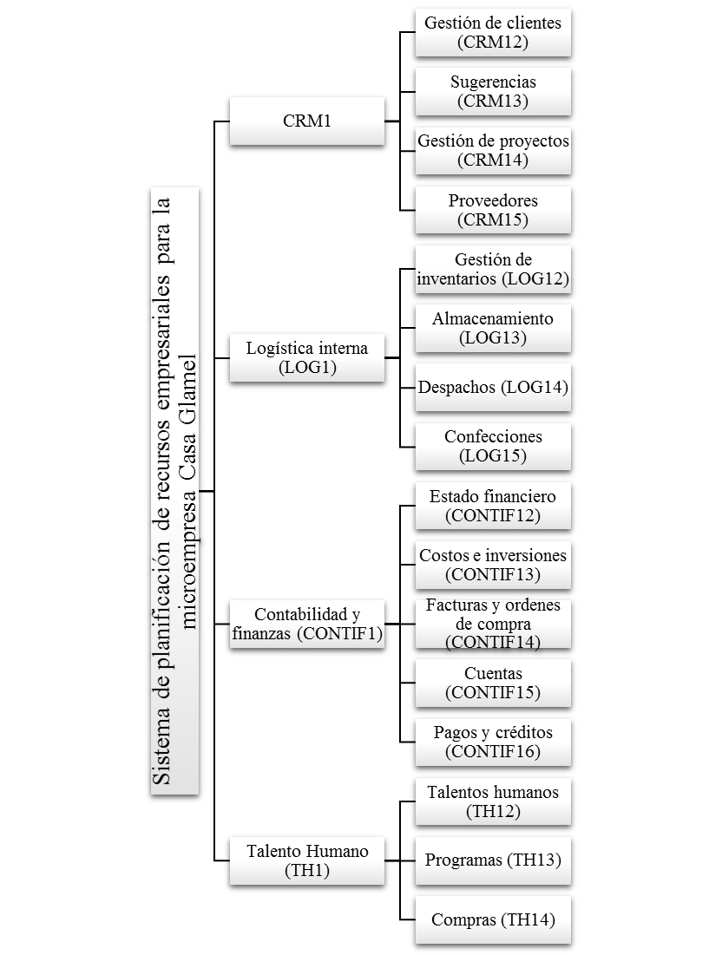
Fig.5

Slide 6
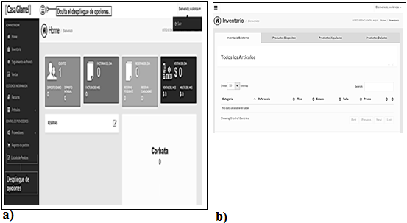
Fig. 6 (a)-(b)

Slide 7
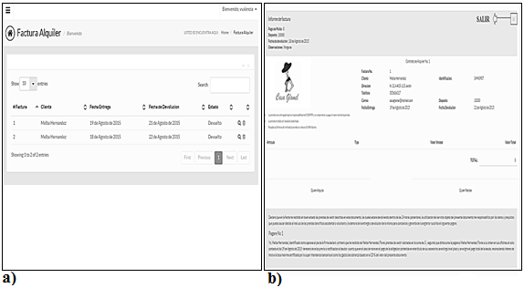
Fig. 7 (a)-(b)

Slide 8
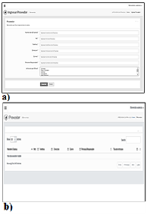
Fig. 8 (a)-(b)

Slide 9
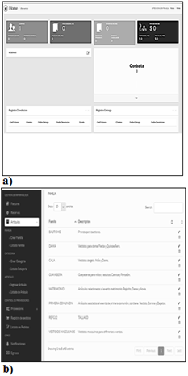
Fig. 9 (a)-(b)

